Slide 1
Automate Data Cleaning Dashboard
Kashfia Sarony, Marwan Otrok, Sugarbayar Enkhbayar
University of Warsaw,
Data science and Business analytics
June 1, 2023
1

Slide 2
Agenda
1. Short description
Why choose?
Aim?
2. Real case
Test dashboard with real example
3. Coding
Automatic data cleaning dashboard
1

Slide 3
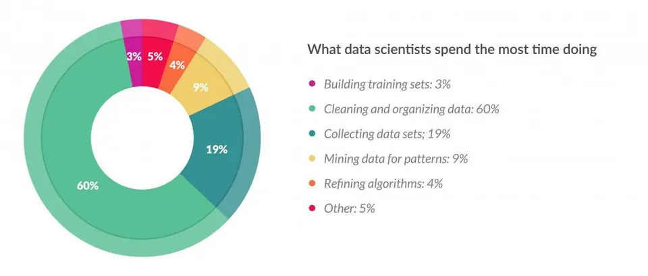
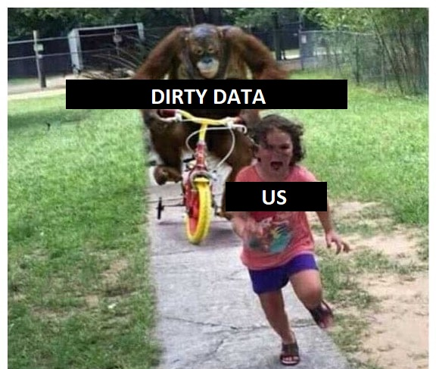
Short description
Data analyst -> We love it, But also We hate it
Data scientists spend 60% of their time on cleaning and organizing data
Aim of the dashboard:
Simple tasks (filter, group by, delete a row, fill missing value…)
Save time
Interactive
Automatic data cleaning dashboard
1

Slide 4
Short description
Input: Raw data xlsx
Tab1: Data cleaning
Tab2: Analytical
Tab3: Visualization
- Remove column
- Change data types
- Change column name
- Filling missing value
- Remove duplicates
- group by and mean,sum
- Remove outliers
- Model (linear regression, classification, cluster)
- Interactive independent variables
- Interactive dependent variable
- Interactive column choice
- Interactive type of chart
Output: clean data (available download)
Automatic data cleaning dashboard
1

Slide 5
Real case
Test dashboard with real case (video)
Automatic data cleaning dashboard
1

Slide 6
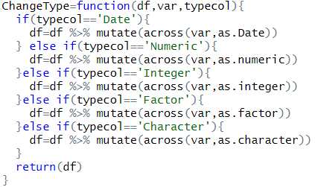
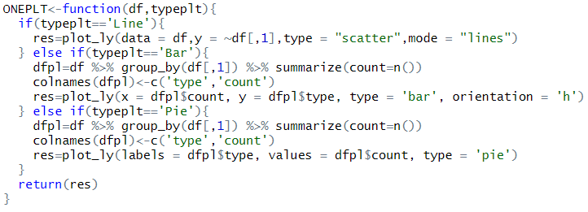
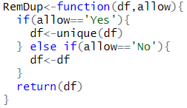
Real case
Topic1: Own advanced functions
Topic2:
OOP
Topic3:
C++
Topic4: Vectorisation
Topic5:
Shiny + dashboard
Topic6:
Create package
Dashboard
Package creating
“Functions”
Automatic data cleaning dashboard
1

Slide 7
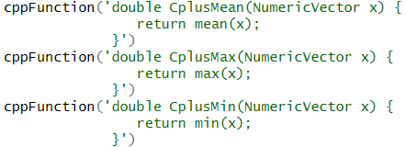

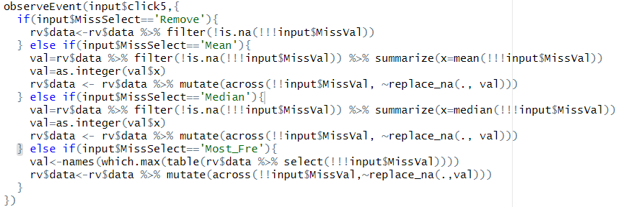
Real case
Topic1: Own advanced functions
Topic2:
OOP
Topic3:
C++
Topic4: Vectorisation
Topic5:
Shiny + dashboard
Topic6:
Create package
Dashboard
“C++ and if statement”
Package creating
Automatic data cleaning dashboard
1

Slide 8
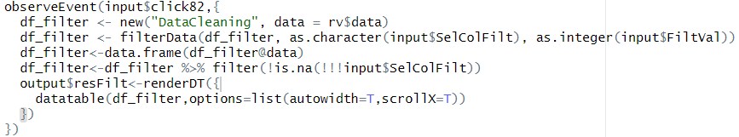
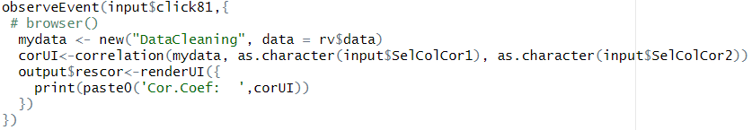
Real case
Topic1: Own advanced functions
Topic2:
OOP
Topic3:
C++
Topic4: Vectorisation
Topic5:
Shiny + dashboard
Topic6:
Create package
Dashboard
“Using own package”
Package creating
Automatic data cleaning dashboard
1

Slide 9
Real case
Please add your slides here
Automatic data cleaning dashboard
1

